Slide 1

Association Rules and
Frequent Item Analysis

Slide 2
Outline
Transactions
Frequent itemsets
Subset Property
Association rules
Applications

Slide 3
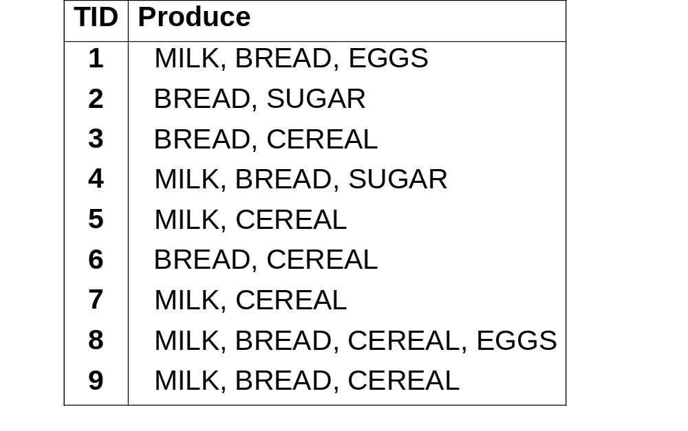
Transactions Example

Slide 4
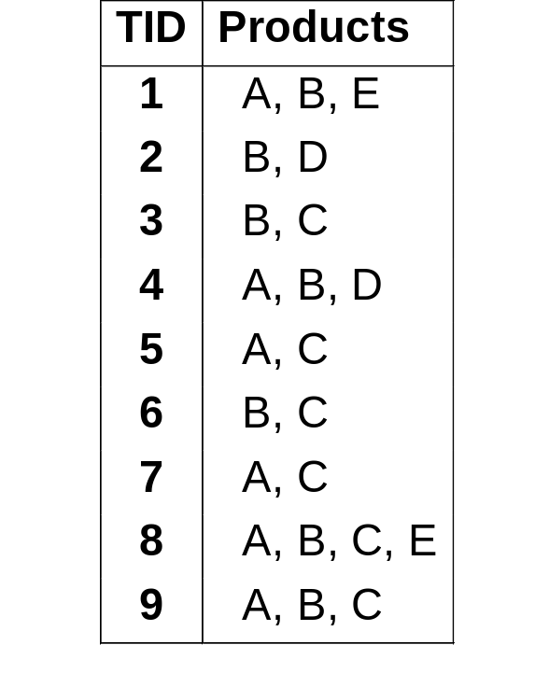
Transaction database: Example, 1
ITEMS:
A = milk
B= bread
C= cereal
D= sugar
E= eggs
Instances = Transactions

Slide 5
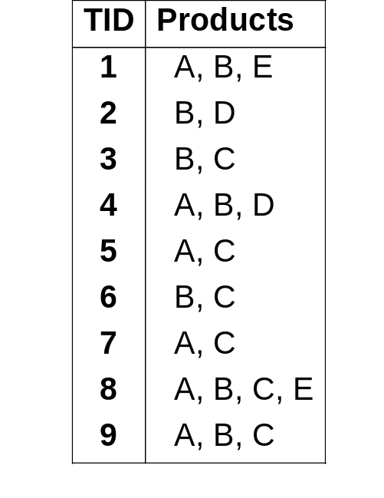
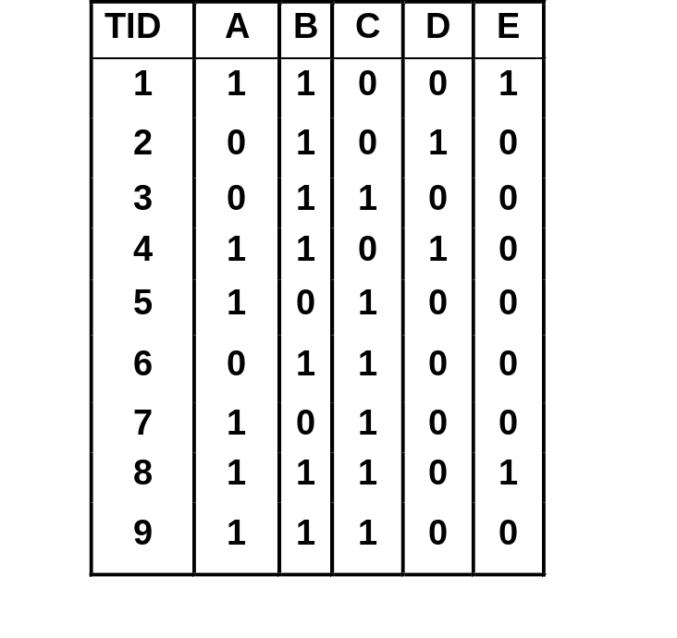
Transaction database: Example, 2
Attributes converted to binary flags

Slide 6
Definitions
Item: attribute=value pair or simply value
  usually attributes are converted to binary flags for each value, e.g. product=“A” is written as “A”
Itemset I : a subset of possible items
  Example: I = {A,B,E} (order unimportant)
Transaction: (TID, itemset)
  TID is transaction ID

Slide 7
Support and Frequent Itemsets
Support of an itemset
  sup(I ) = no. of transactions t that support (i.e. contain) I
In example database:
  sup ({A,B,E}) = 2, sup ({B,C}) = 4
Frequent itemset I is one with at least the minimum support count
  sup(I ) >= minsup

Slide 8
SUBSET PROPERTY
Every subset of a frequent set is frequent!
Q: Why is it so?
A: Example: Suppose {A,B} is frequent. Since each occurrence of A,B includes both A and B, then both A and B must also be frequent
Similar argument for larger itemsets
Almost all association rule algorithms are based on this subset property

Slide 9
Association Rules
Association rule R : Itemset1 => Itemset2
  meaning: if transaction includes Itemset1 then it also has Itemset2
Examples
  A,B => E,C
  A => B,C

Slide 10
From Frequent Itemsets to Association Rules
Q: Given frequent set {A,B,E}, what are possible association rules?
  A => B, E
  A, B => E
  A, E => B
  B => A, E
  B, E => A
  E => A, B

Slide 11
Classification vs Association Rules
Classification Rules
Focus on one target field
Specify class in all cases
Measures: Accuracy
Association Rules
Many target fields
Applicable in some cases
Measures: Support, Confidence

Slide 12
Rule Support and Confidence
Suppose R : I => J is an association rule
  sup (R) = sup (I ∪ J) is the support count
    support of itemset I ∪ J (I or J)
  conf (R) = sup(J) / sup(R) is the confidence of R
    fraction of transactions with I ∪ J that have J
Association rules with minimum support and count are sometimes called “strong” rules

Slide 13
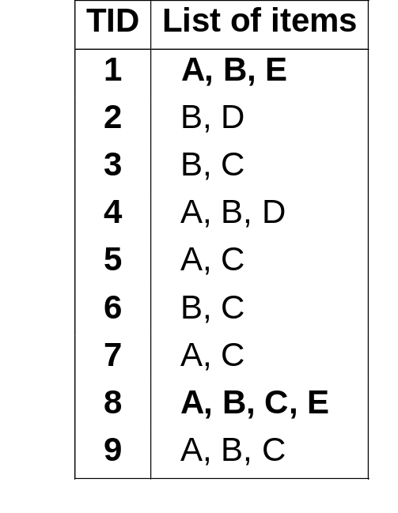
Association Rules Example, 1
Q: Given frequent set {A,B,E}, what association rules have minsup = 2 and minconf= 50% ?
A, B => E : conf=2/4 = 50%

Slide 14
Association Rules Example, 2
Q: Given frequent set {A,B,E}, what association rules have minsup = 2 and minconf= 50% ?
A, B => E : conf=2/4 = 50%
A, E => B : conf=2/2 = 100%
B, E => A : conf=2/2 = 100%
E => A, B : conf=2/2 = 100%
Don’t qualify
A =>B, E : conf=2/6 =33%< 50%
B => A, E : conf=2/7 = 28% < 50%

Slide 15
Example: Generating Rules from an Itemset
Frequent itemset from golf data:
Six potential rules:
Humidity = Normal, Windy = False, Play = Yes (?)
Outlook | Temp | Humidity | Windy | Play
Sunny | Hot | High | False | No
Sunny | Hot | High | True | No
Overcast | Hot | High | False | Yes
Rainy | Mild | High | False | Yes
Rainy | Cool | Normal | False | Yes
Rainy | Cool | Normal | True | No
Overcast | Cool | Normal | True | Yes
Sunny | Mild | High | False | No
Sunny | Cool | Normal | False | Yes
Rainy | Mild | Normal | False | Yes
Sunny | Mild | Normal | True | Yes
Overcast | Mild | High | True | Yes
Overcast | Hot | Normal | False | Yes
Rainy | Mild | High | True | No
If Humidity = Normal and Windy = False then Play = Yes If Humidity = Normal and Play = Yes then Windy = False If Windy = False and Play = Yes then Humidity = Normal If Humidity = Normal then Windy = False and Play = Yes If Windy = False then Humidity = Normal and Play = Yes If Play = Yes then Humidity = Normal and Windy = False

Slide 16
Example: Generating Rules from an Itemset
Frequent itemset from golf data:
Six potential rules:
Humidity = Normal, Windy = False, Play = Yes (4)
If Humidity = Normal and Windy = False then Play = Yes If Humidity = Normal and Play = Yes then Windy = False If Windy = False and Play = Yes then Humidity = Normal If Humidity = Normal then Windy = False and Play = Yes If Windy = False then Humidity = Normal and Play = Yes If Play = Yes then Humidity = Normal and Windy = False | 4/4 4/6 4/6 4/7 4/8 4/9

Slide 17
Rules for the weather data
Rules with support > 1 and confidence = 100%:
In total: 3 rules with support four, 5 with support three, and 50 with support two
 | Association rule |  | Sup. | Conf.
1 | Humidity=Normal Windy=False | ⇒Play=Yes | 4 | 100%
2 | Temperature=Cool | ⇒Humidity=Normal | 4 | 100%
3 | Outlook=Overcast | ⇒Play=Yes | 4 | 100%
4 | Temperature=Cold Play=Yes | ⇒Humidity=Normal | 3 | 100%
... | ... | ... | ... | ...
58 | Outlook=Sunny Temperature=Hot | ⇒Humidity=High | 2 | 100%

Slide 18
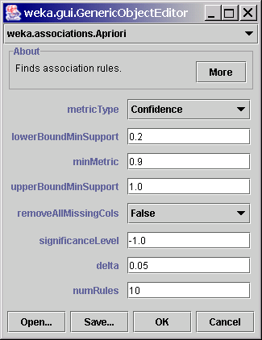
Weka associations
File: weather.nominal.arff
MinSupport: 0.2

Slide 19
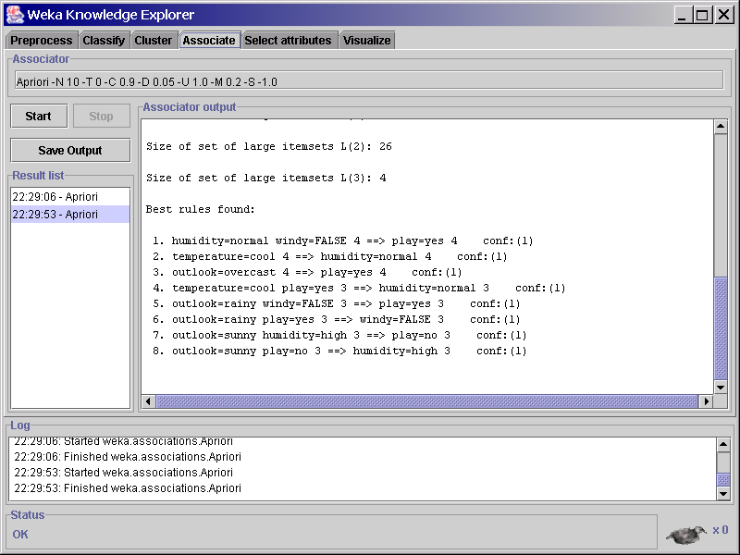
Weka associations: output

Slide 20
Other issues
ARFF format very inefficient for typical market basket data
  Attributes represent items in a basket and most items are usually missing
Interestingness of associations
  find unusual associations: Milk usually goes with bread, but soy milk does not.

Slide 21
Applications
Market basket analysis
  Store layout, client offers
Finding unusual events
  WSARE – What is Strange About Recent Events
…

Slide 22
Application Difficulties
Wal-Mart knows that customers who buy Barbie dolls have a 60% likelihood of buying one of three types of candy bars.
What does Wal-Mart do with information like that? 'I don't have a clue,' says Wal-Mart's chief of merchandising, Lee Scott
See - KDnuggets 98:01 for many ideas www.kdnuggets.com/news/98/n01.html
Diapers and beer urban legend

Slide 23
Summary
Frequent itemsets
Association rules
Subset property
Apriori algorithm
Application difficulties

